Slide 1
Course Name : Data Structures & Algorithms
Bharat Deshpande
Computer Science & Information Systems

Slide 2
Deletion in an AVL Tree
Removal begins as in a binary search tree, which means the node removed will become an empty external node. Its parent, w, may cause an imbalance.
Example:
44
44
17
62
17
62
32
50
78
50
78
48
54
88
48
54
88
before deletion of 32
after deletion

Slide 3
Deletion in an AVL Tree
Let z be the first unbalanced node encountered while travelling up the tree from w. Also,
let y be the child of z with the larger height,
let x be the child of y defined as follows;
If one of the children of y is taller than the other, choose x as the taller child of y.
If both children of y have the same height, select x be the child of y on the same side as y (i.e., if y is the left child of z, then x is the left child of y; and if y is the right child of z then x is the right child of y.)

Slide 4
Trinode Restructuring
We perform restructure(x) to restore balance at z.
As this restructuring may upset the balance of another node higher in the tree, we must continue checking for balance until the root of T is reached
a=z
62
44
w
44
78
17
62
b=y
c=x
17
50
88
50
78
48
54
48
54
88

Slide 5
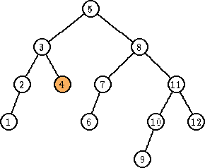
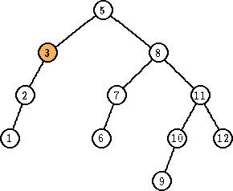
Deletion - Example
Delete 4
Imbalance at 3
Perform rotation with 2

Slide 6
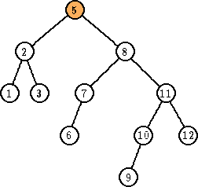
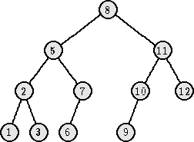
Example – Contd.
Imbalance at 5
Perform rotation with 8

Slide 7
Running Times for AVL Trees
a single restructure is O(1)
using a linked-structure binary tree
find is O(log n)
height of tree is O(log n), no restructures needed
insert is O(log n)
initial find is O(log n)
Restructuring up the tree, maintaining heights is O(log n)
remove is O(log n)
initial find is O(log n)
Restructuring up the tree, maintaining heights is O(log n)

Slide 8
Multi-Way Search Trees
Each internal node of a multi-way search tree T:
has at least two children, i.e., each internal node is a d-node, d>=2
stores a collection of items of the form (k, x), where k is a key and x is an element
Each d – node with children v1,…,vd contains d - 1 items, stored in increasing order
“contains” 2 pseudo-items: k₀=-∞ , k_{d}= ∞. For each item (k, x) stored at a node in the subtree of v rooted at vi, I =1,…,D, we have k_{i-1} ≤ k ≤ k_{i}
Children of each internal node are “between” items
all keys in the subtree rooted at the child fall between keys of those items

Slide 9
Multi-way Searching
Similar to binary searching
If search key s<k₁ search the leftmost child
If s>k_{d-1} , search the rightmost child
That’s it in a binary tree; what about if d>2?
Find two keys k_{i-1} and k_{i} between which s falls, and search the child v_{i}.
3 4

Slide 10
Performance
Worst Case – O(h logd)
where d is the maximum number of children of any node
If d is constant, then running time is O(h)
Prime Goal
Try to keep h as small as possible

Slide 11
(2, 4) or (2, 3, 4) Trees
(2, 4) tree is a multi-way search tree with the following two properties:
Size property:
Nodes may contain 1, 2 or 3 items & a node with k
items has k + 1 children
Depth property:
All the external nodes have same depth

Slide 12
Example
10 45
70 90 100
3 8
25 38

Slide 13
Height of (2, 4) tree
Result:
A multi-way search tree storing n items has n + 1
external nodes.
Can be proved by induction
Main Result :
Height of a (2, 4) tree storing n items is O(logn)

Slide 14
Proof
Let h be the height of (2, 4) tree T storing n items.
Then the number of external nodes in T is at most 4^{h}
& the number of external nodes in T is at least 2^{h}
Therefore,
2^{h} ≤ n +1 ≤ 4^{h}
Taking logarithm in base 2, we get that
h ≤ log(n+1) and log(n+1) ≤ 2h, which proves the result.

